Slide 1
Discourse markers

Slide 2
Discourse markers/ sentence linkers
Discourse markers are words or expressions that link, manage and help to organise sentences. Linkers make it easy for us to compare, contrast, illustrate, define, and summarize our thoughts and develop coherent paragraphs.
Discourse markers are also called as
Sentence linkers/ sentence connectors
linking words/ phrases
Transition signals
Linkers are words that relate one idea or sentence of the text with another. They establish connection between the ideas logically. Discourse markers can be placed in any part of a sentence.
They are important to make your speech or text flow and to avoid a series of short unconnected statements.

Slide 3
uses
To organize ideas in sequence
To balance contrasting points
To introduce a new idea
To present a counter argument
To change the topic
To clarify ideas
To sum up ideas
To indicate opinion
To compare and contrast
To give examples

Slide 4
Let us look at some examples.
The north of the country is industrialised and rich whereas the south is quite poor, with an economy based on agriculture.
Basically , our objective is to improve enrollment and quality of education at the same time.
We should better find a quick solution to this crisis, otherwise our customers will start to lose faith in us.
On the whole, we liked the technical support we received from the three companies, although X-Tech and Fast-on were a bit faster.
I saw Jerry and Cath today. Talking of Jerry, do you know that he's going to Australia on a business trip next week?
You should help her in whatever she may need; after all , she's your sister.

Slide 5
These expressions are used to add information or arguments to what has already been said.
in addition, again, as well as that, besides, equally important, finally, further, furthermore, in addition, moreover, next, too, what is more, Another thing, also, additionally, One more thing
As a conjunct, besides has a very specific meaning: 'I have just provided a series of arguments for supporting a claim; here is the last argument, and it is the decisive one, perhaps even strong enough to make the other arguments more or less irrelevant'.
It is used when you are adding another stronger reason to support what you are saying.
Besides is used to emphasize an additional point that you are making, especially one that you consider to be important.
Shelly gave up looking for work. She said that she had too many projects of her own to concentrate on, and besides, she just wasn't "the office type."
Although furthermore and moreover are described as more or less synonymous in most dictionaries, there are nevertheless subtle differences. The main use of furthermore is to add one more point to a list of points already made. Moreover, on the other hand, is rhetorically more powerful than furthermore in that it tends to introduce an argument which has greater weight for the writer.

Slide 6
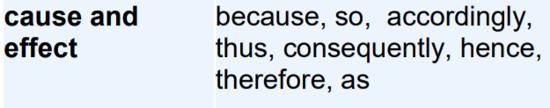
Cause and consequence
Accordingly is rather formal and by no means the most common of the causal connectives.
Accordingly expresses a causal relation where the resulting action is natural rather than a necessary consequence.
Eg) For many decades Britain and the United States enjoyed a special relationship. Accordingly, the red carpet was well and truly rolled out every time the political leaders met.
Use consequently when you want to stress that there is very good reason to deduce one thing from another.
In many murder enquiries absolute secrecy is a prerequisite for succcess. Consequently, the press is often kept in the dark about police activities.
Like therefore, hence expresses the idea that what follows is a necessary deduction from what precedes. However, while therefore stresses the relative importance of what follows, you can use hence to emphasize the relative importance of what went before.

Slide 7
Often the best position for therefore in terms of rhythm is not at the beginning of a sentence but rather immediately before the verb
Many people therefore regard the situation in Ireland as potentially explosive
It is therefore recommended that employees make use of the new faciliies.
Note that therefore does not need separating from the rest of the sentence by commas.

Slide 8
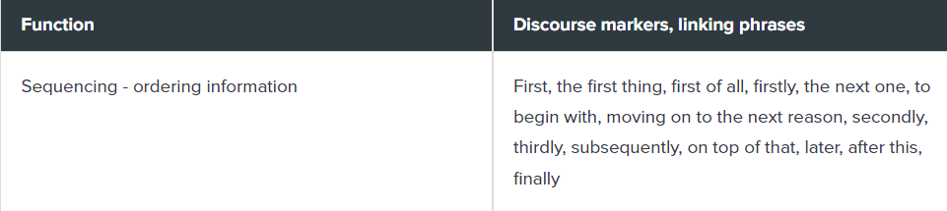
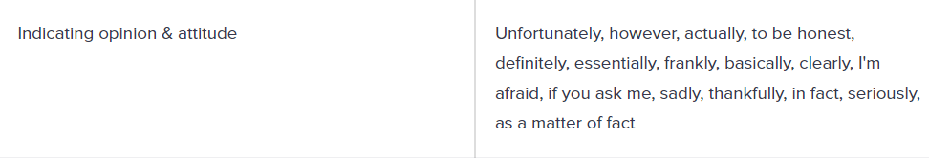

Slide 9
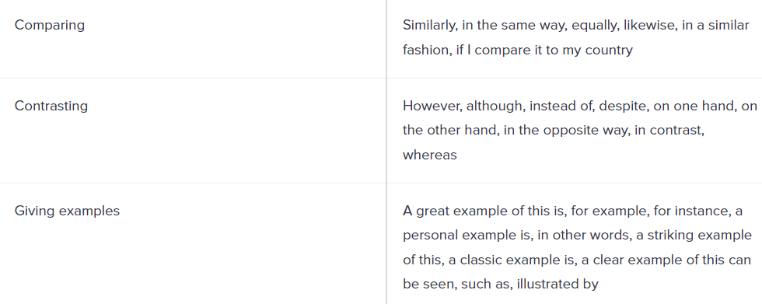

Slide 10
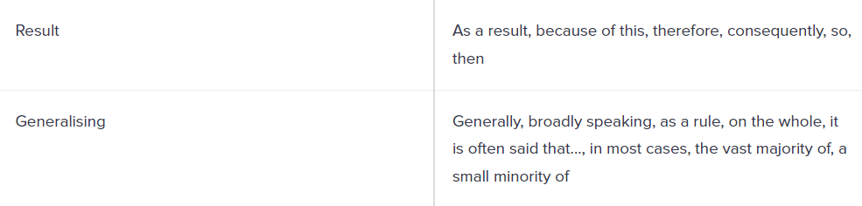
…….

Slide 11
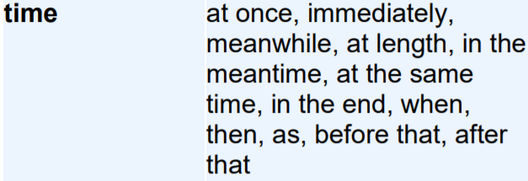
.

Slide 12
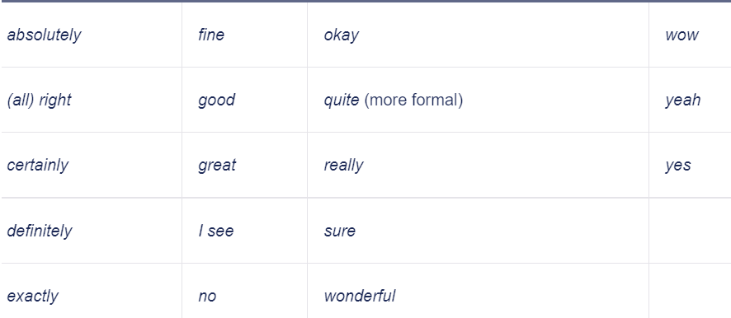
Discourse markers as responses

Slide 13
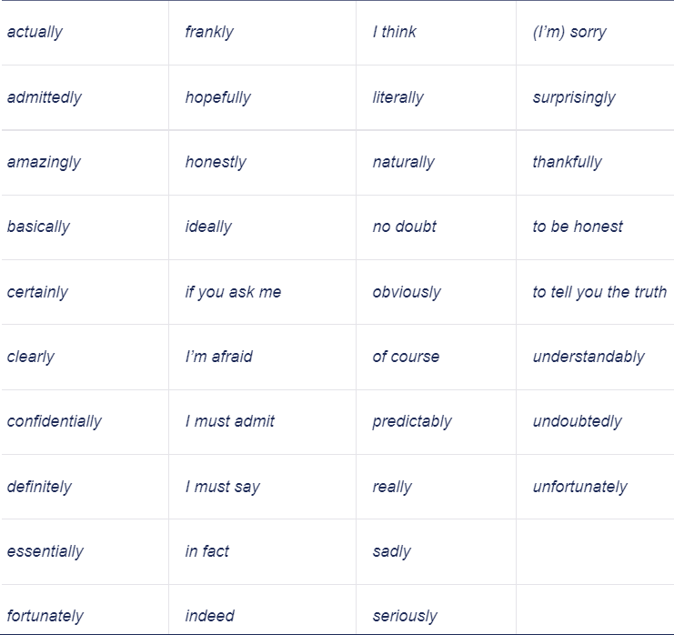
Discourse markers showing attitude
Some expressions are used to mark attitude or point of view in speaking or writing.

Slide 14
Interjections
This type of discourse markers has been described in most books of grammars. Interjections are words or set of sounds used as a sudden remark to express feelings
Oh [ ] Surprise
Wow [ ] great Surprise.
Ow [ ] pain
Yippee [ ] excitement, delight

Slide 15
Greeting and Farewells Expressions
Greetings and Farewells occur in special discourse situations and constitute conventionalized responses to these situations, despite their phatic use (Schourup, 1985:11) argues, these markers can be used as an instrument to maintain a link among people.
In general, greeting can very in formality, hi and hello are used in informal situations. They are less formal than "good" forms: good morning, good afternoon and good evening

Slide 16
